Slide 1

Project Title -CAR MARKET TRENDS ANALYSIS
AICTE STU ID : STU658046cf7f3e11702905551
-Presented By
Velampalli Venkata Sai Sujeevan

Slide 2

PROBLEM STATEMENT
The automobile market contains a large amount of vehicle information such as manufacturing year, selling price, present price, fuel type, kilometers driven, ownership and transmission.
Analyzing this information manually is difficult and time-consuming.
The main objective of this project is to develop a system that can analyze vehicle data automatically and provide meaningful insights about car market trends, vehicle prices, depreciation and value retention through an interactive web application.

Slide 3
Project Description
Car Market Trends Analysis is a web-based data analytics project developed using the CarDekho dataset.
The application processes vehicle information using Python and Pandas and presents the analysis through an interactive Flask website.
The system allows users to explore vehicle information, analyze individual vehicles and view automatically generated results from the dataset.
The project analyzes important vehicle attributes such as:
Vehicle Name
Manufacturing Year
Selling Price
Present Price
Kilometers Diven
Fuel Type
Seller Type
Transmission
Ownership

Slide 4
Objectives
The main objectives of the project are:
To analyze automobile market data.
To identify vehicle price trends.
To calculate vehicle depreciation.
To calculate vehicle value retention.
To analyze manufacturing year information.
To study fuel type distribution.
To compare manual and automatic vehicles.
To identify missing values in the dataset.
To provide an interactive vehicle analysis system.
To visualize data using charts and graphs.

Slide 5

WHO ARE THE END USERS?
This application can be useful for the following users:
Car Buyers
To understand vehicle prices and depreciation before purchasing a vehicle.
Car Sellers
To analyze vehicle value and selling prices.
Automobile Dealers
To understand vehicle market trends and pricing patterns.
Data Analysts
To analyze and visualize automobile datasets.
Students
To learn about Python, Pandas, Flask and Data Analytics.
Researchers
To study automobile market trends and vehicle value changes.

Slide 6

Technology Used
Python – Used for data processing and project logic.
Flask – Used to develop the backend and connect the website with Python.
Pandas – Used to read, clean, process, and analyze the CarDekho dataset.
HTML – Used to create the structure of the web pages.
CSS – Used to design and style the website interface.
JavaScript – Used to add interactivity such as dropdowns, dark/light mode, chatbot UI, and dynamic features.
Jupyter Notebook – Used for initial data analysis and experimentation.
Matplotlib – Used to create graphs and visualizations during data analysis.
Chart.js – Used to display interactive charts on the web dashboard.
VS Code – Used to write and manage the project code.
GitHub – Used to store and manage the project source code.
Vercel – Used to deploy the project online.

Slide 7
Working Process
CarDekho Dataset
Data Processing
Data Analysis
Flask Backend
Web Application
Dashboard & Visualization

Slide 8
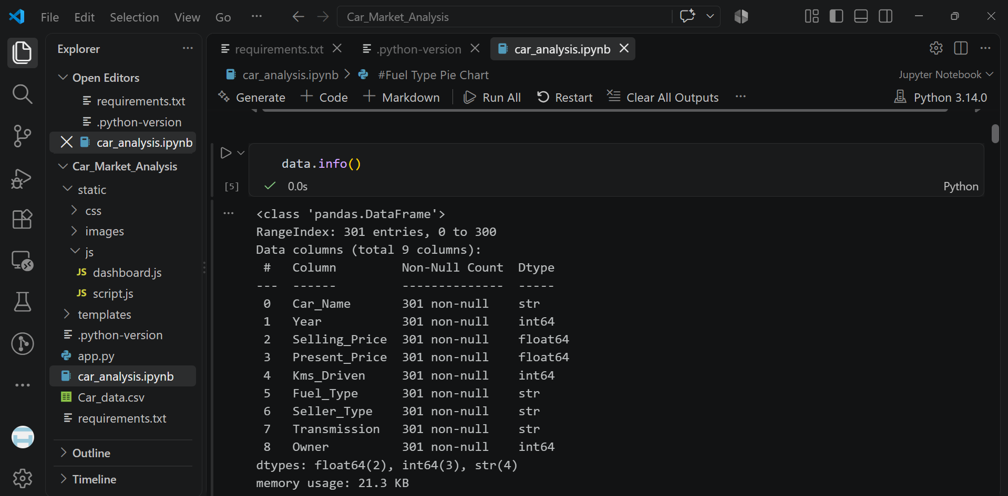
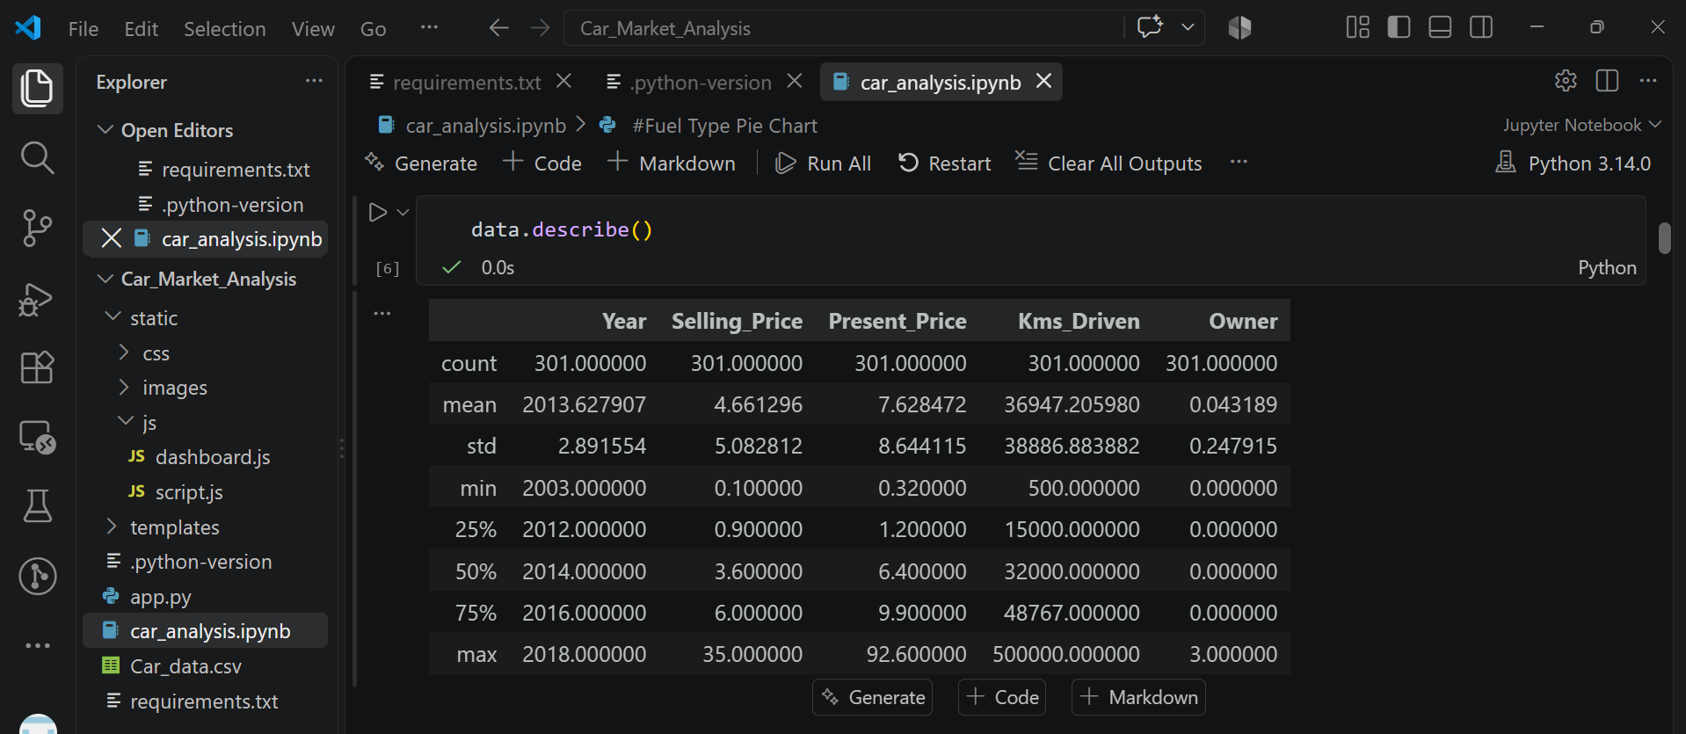
RESULTS
The CarDekho dataset was analyzed using Jupyter Notebook with Python and Pandas. Different operations were performed to understand vehicle prices, manufacturing years, fuel types, depreciation, and other market trends.
[Add screen shots of your code ]
Git hub repo link Vercel link

Slide 9
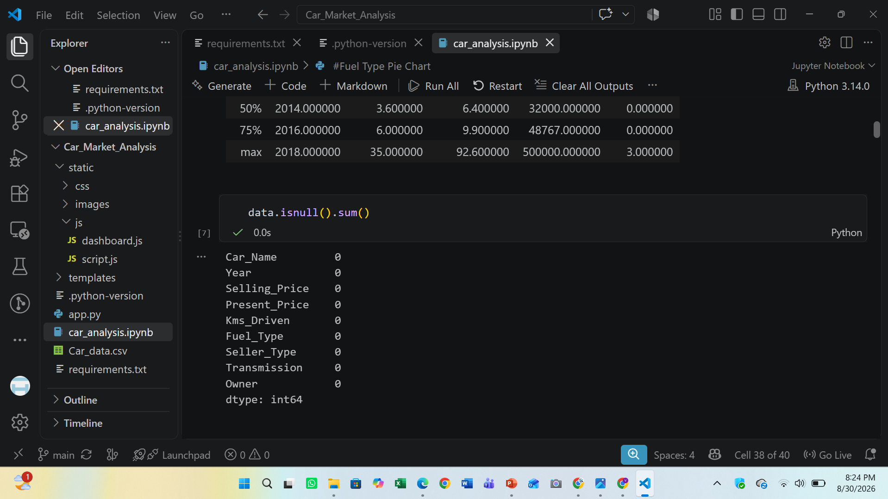
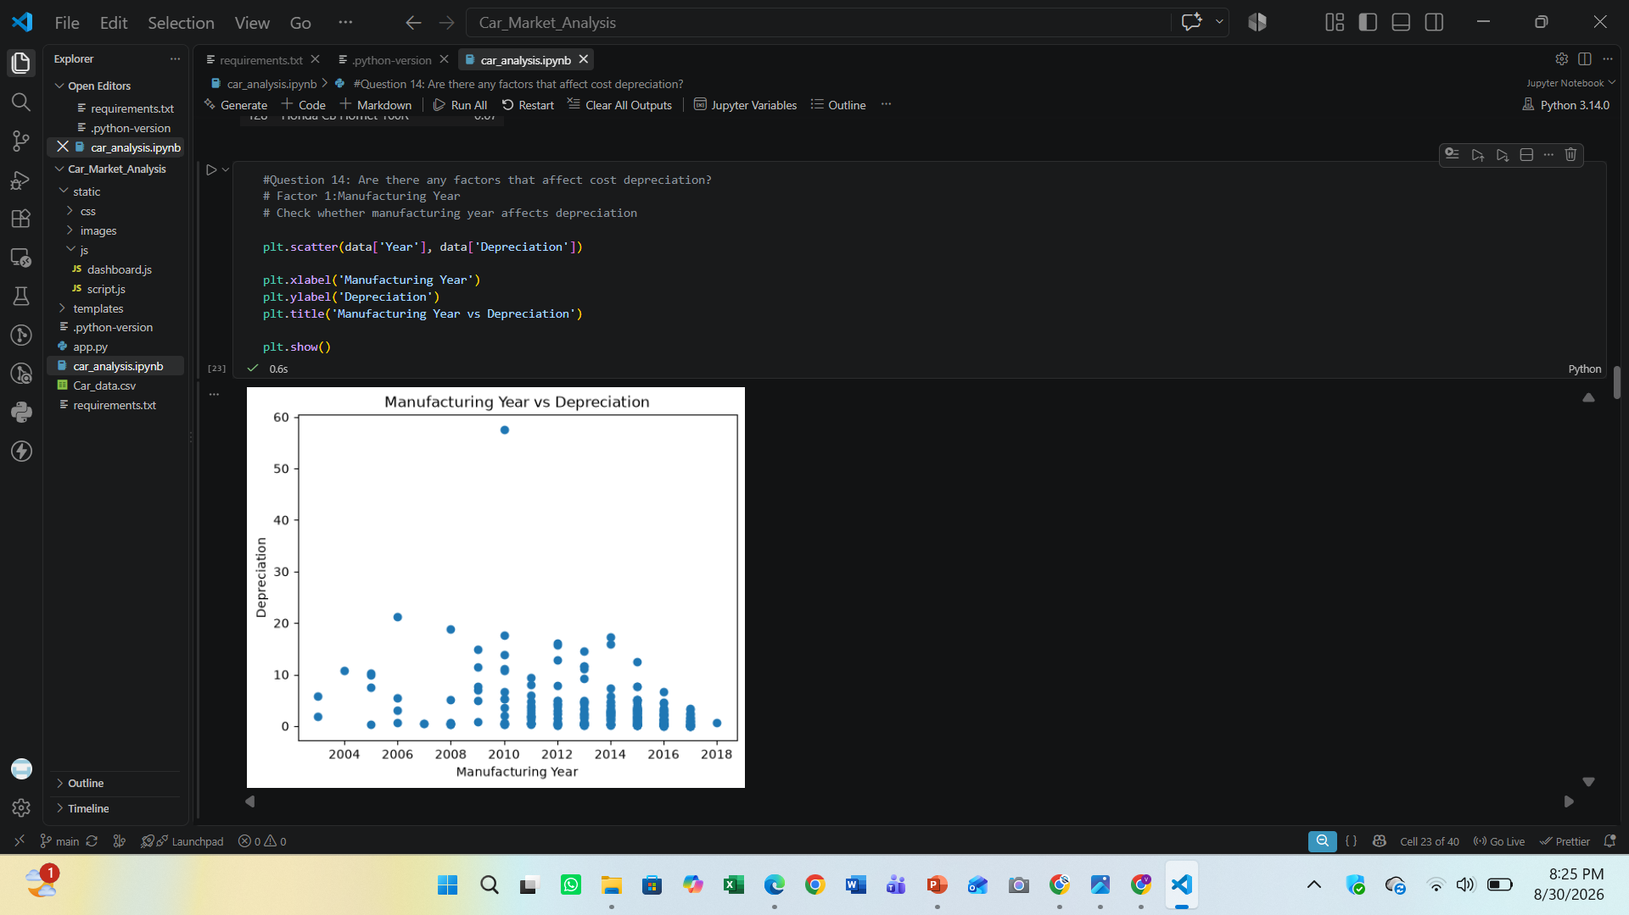
RESULTS
[Add screen shots of your code ]
Demo Link

Slide 10
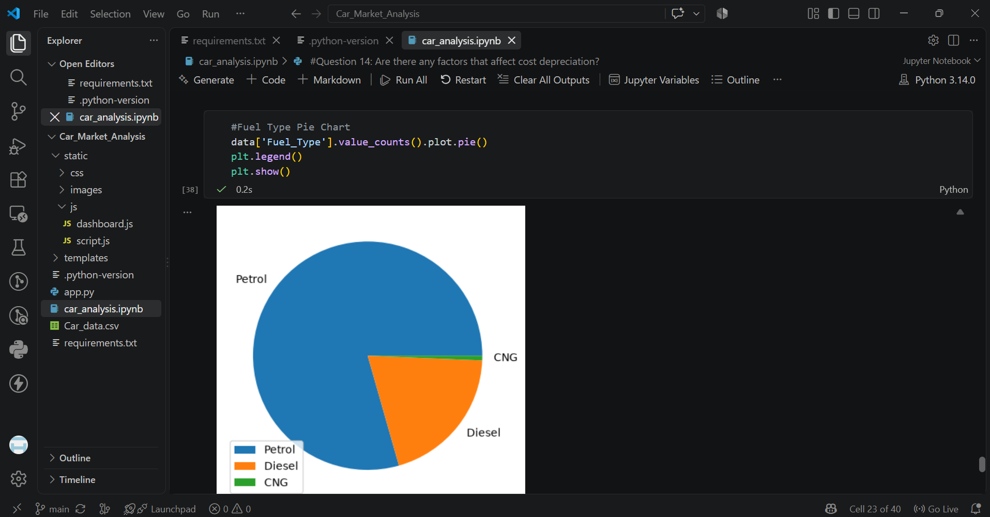
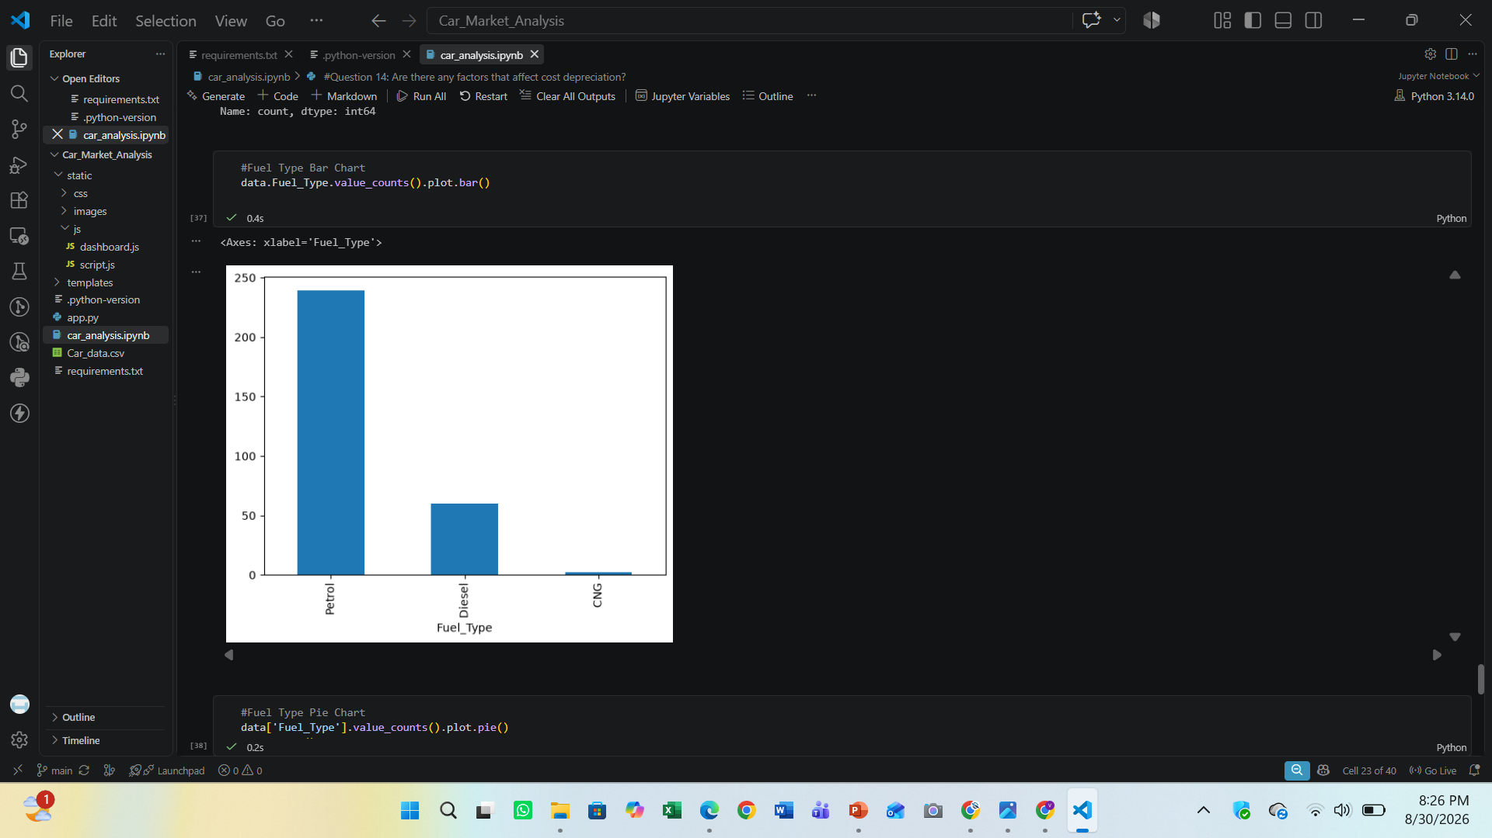
RESULTS
[Add screen shots of your code ]
Demo Link

Slide 11
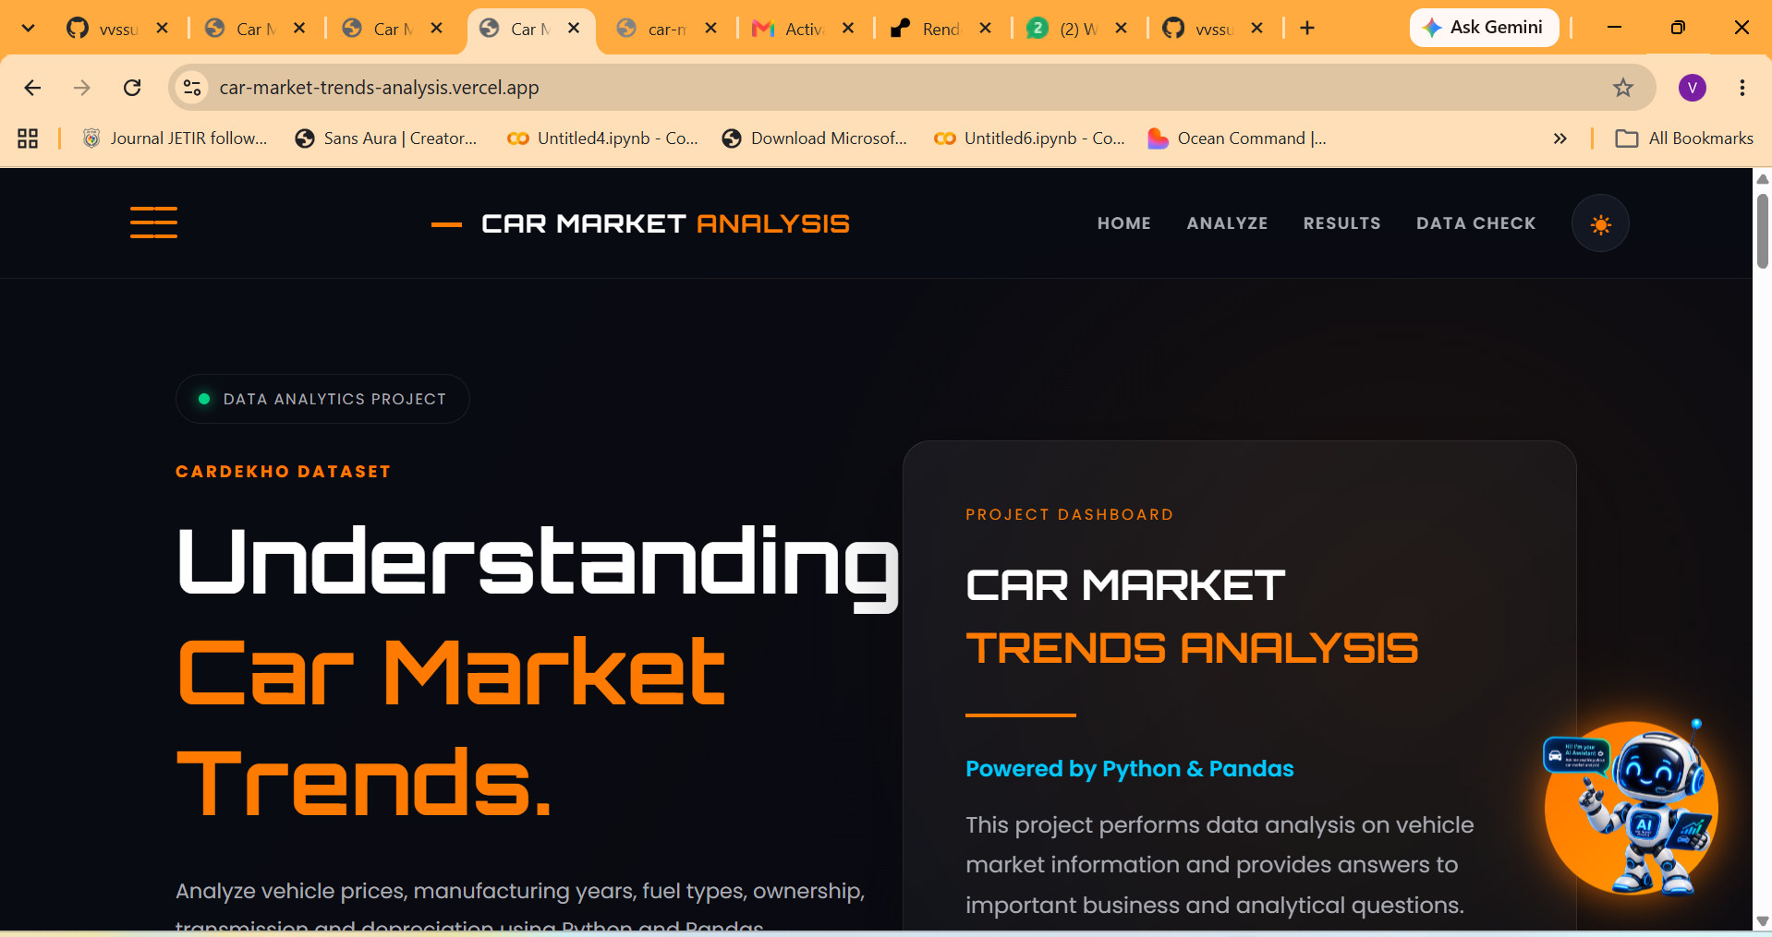
RESULTS
[Add screen shots of your code ]
Demo Link

Slide 12
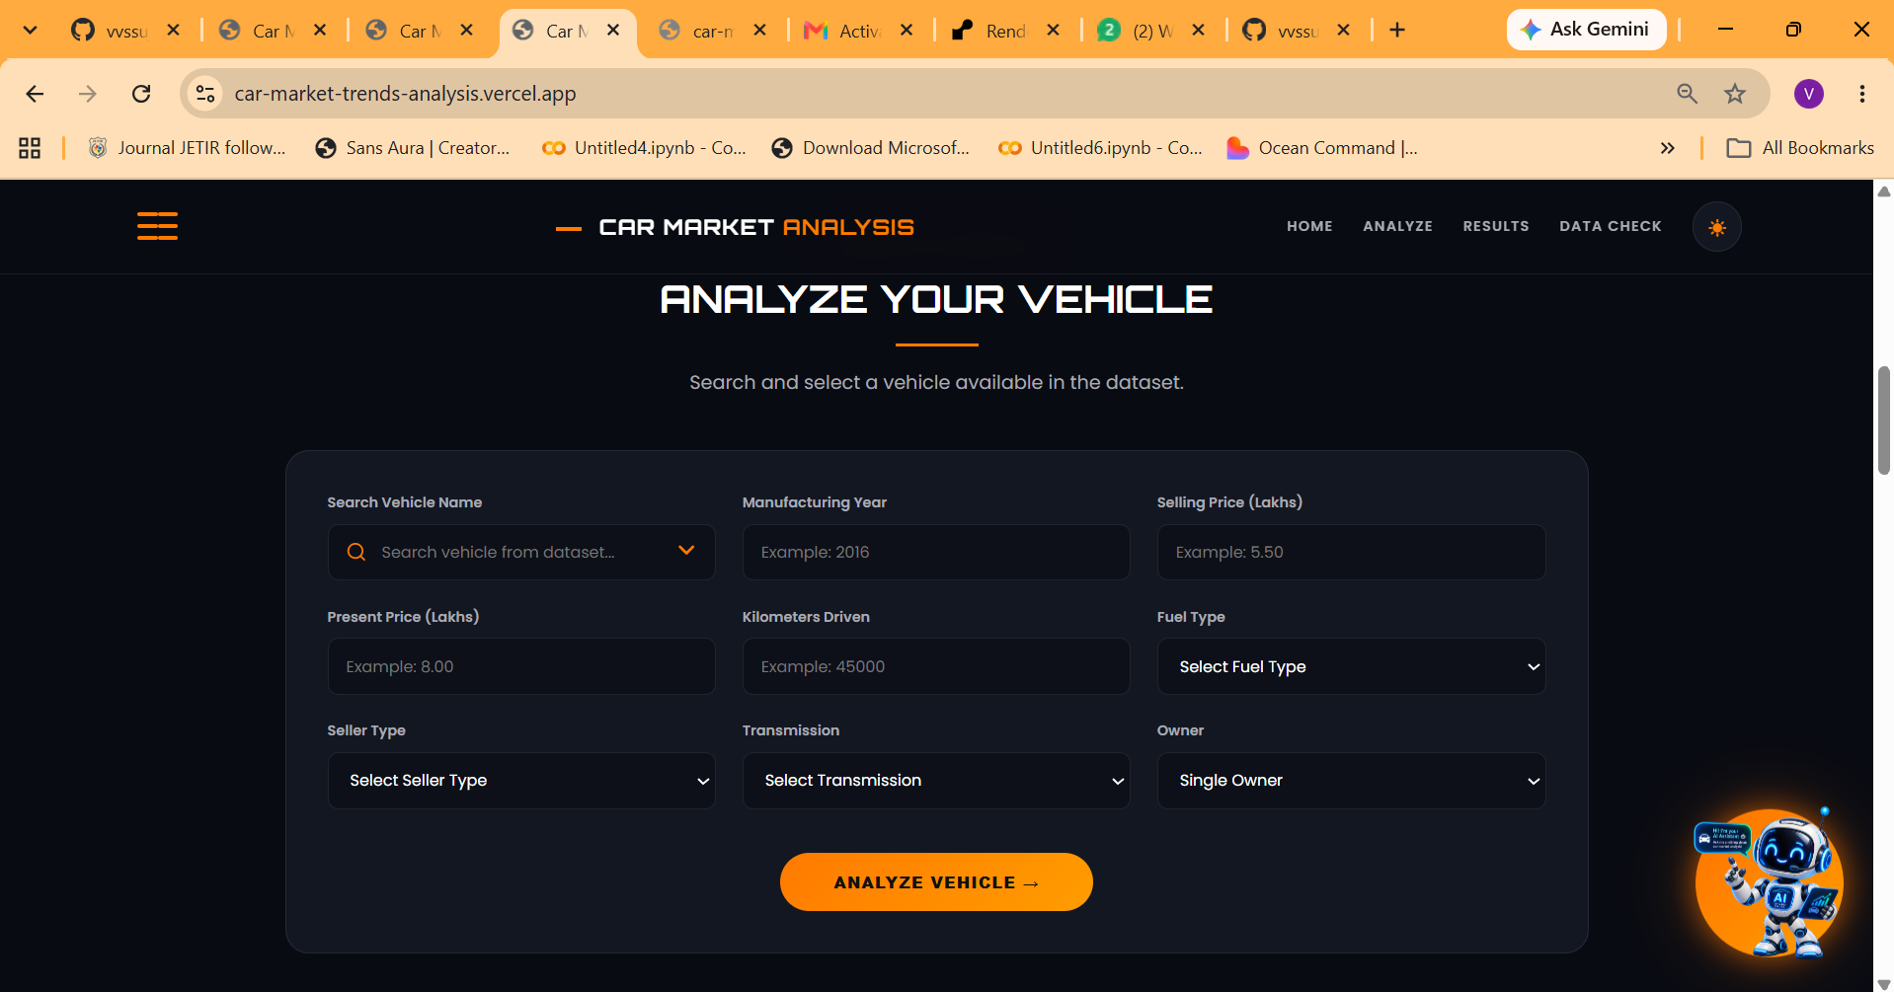
RESULTS
[Add screen shots of your code ]
Demo Link

Slide 13
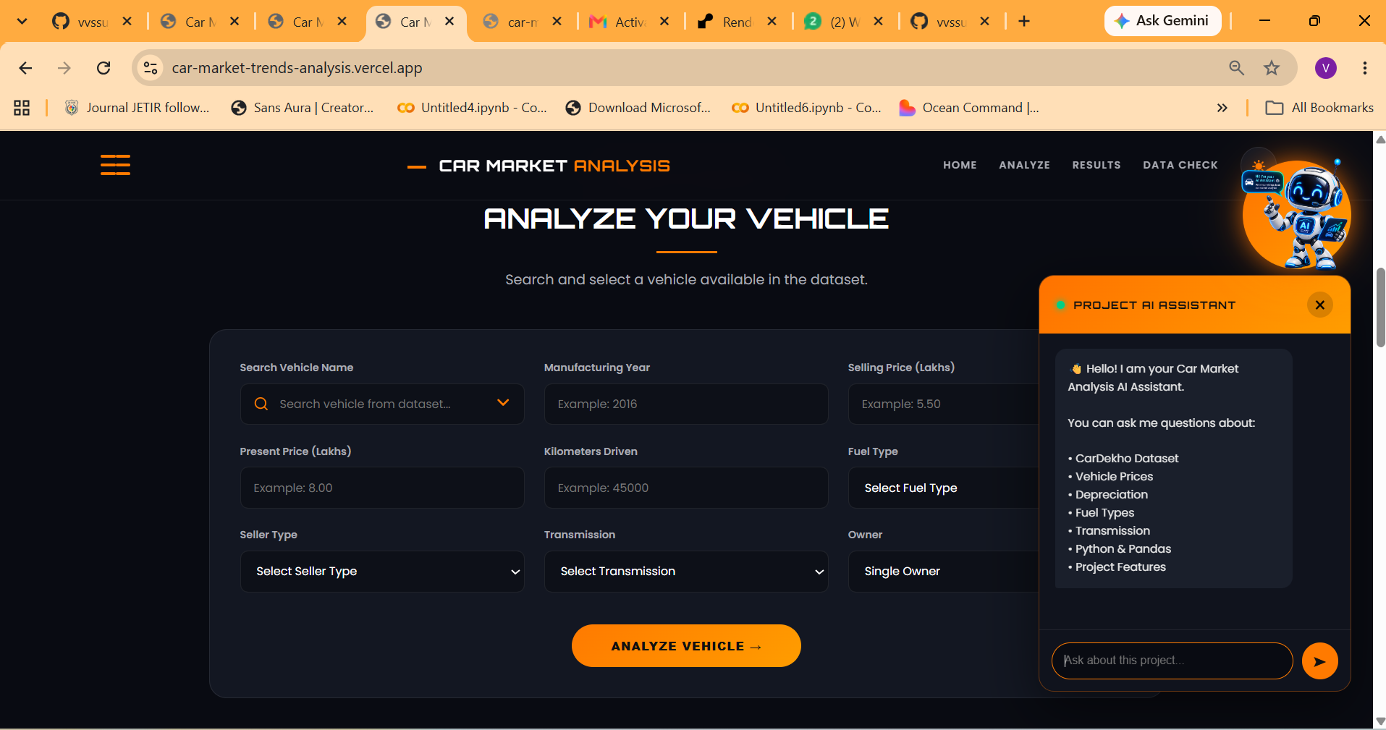
RESULTS
[Add screen shots of your code ]
Demo Link

Slide 14
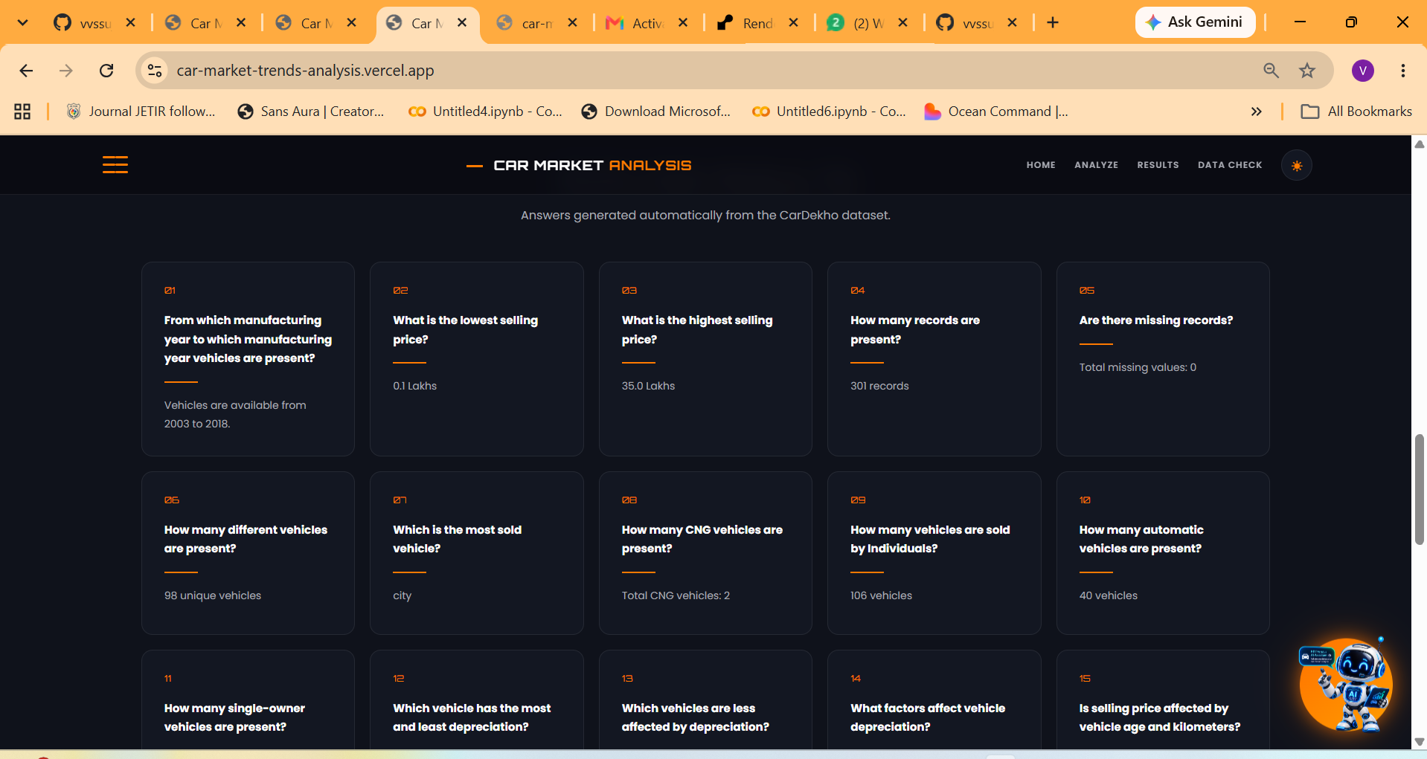
RESULTS
[Add screen shots of your code ]
Demo Link

Slide 15
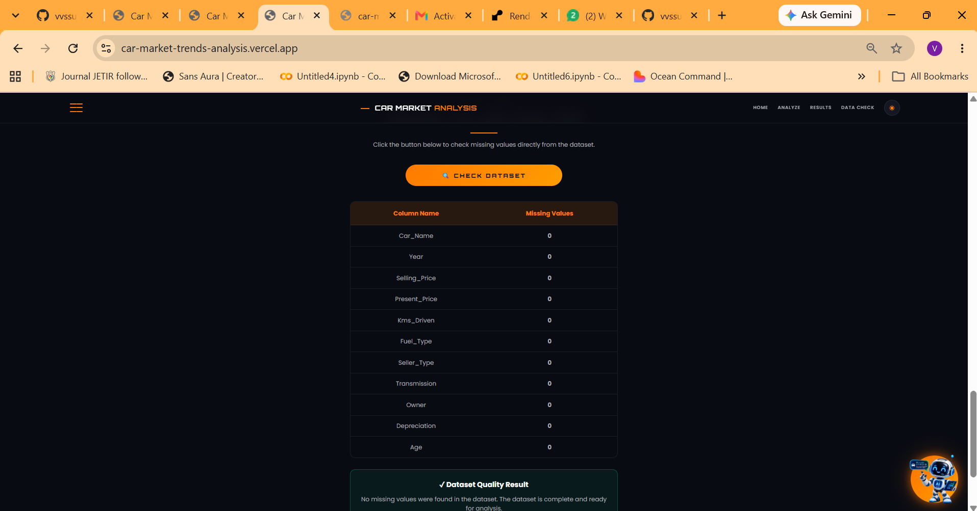
RESULTS
[Add screen shots of your code ]
Demo Link

Slide 16
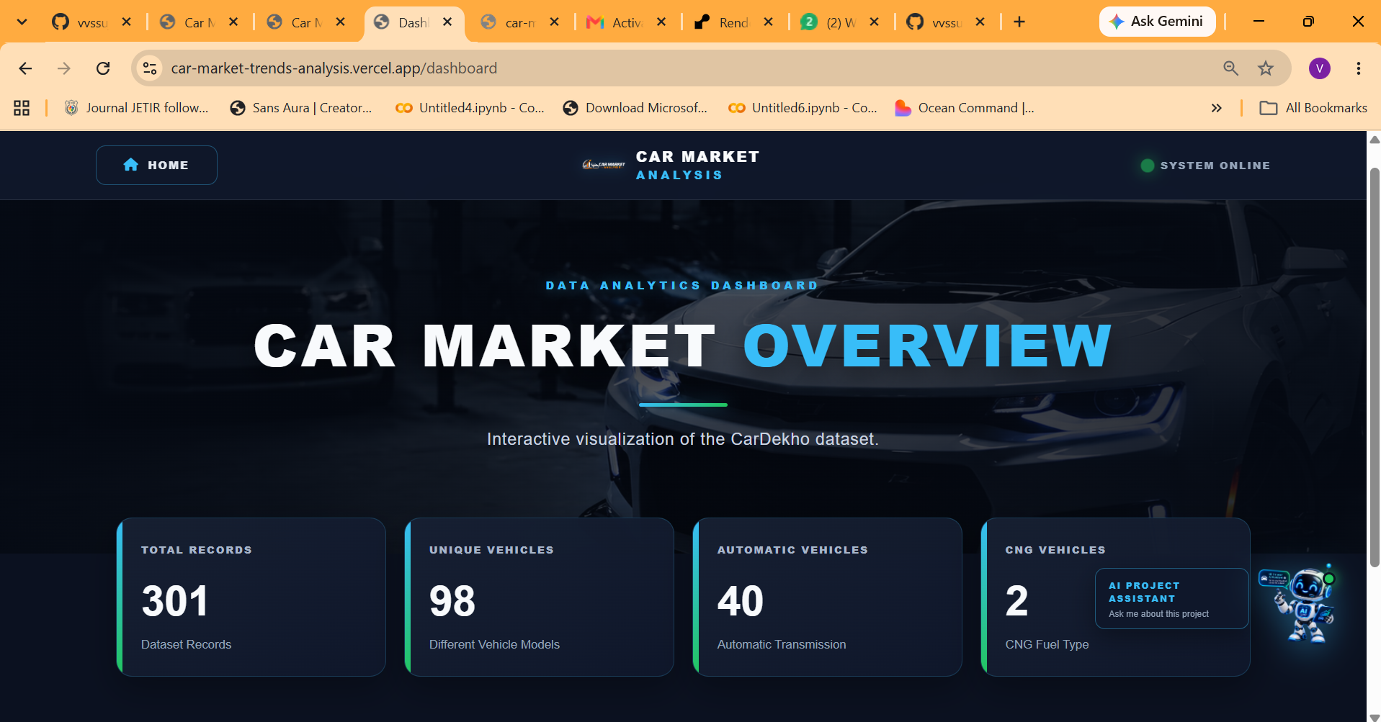
RESULTS
[Add screen shots of your code ]
Demo Link

Slide 17
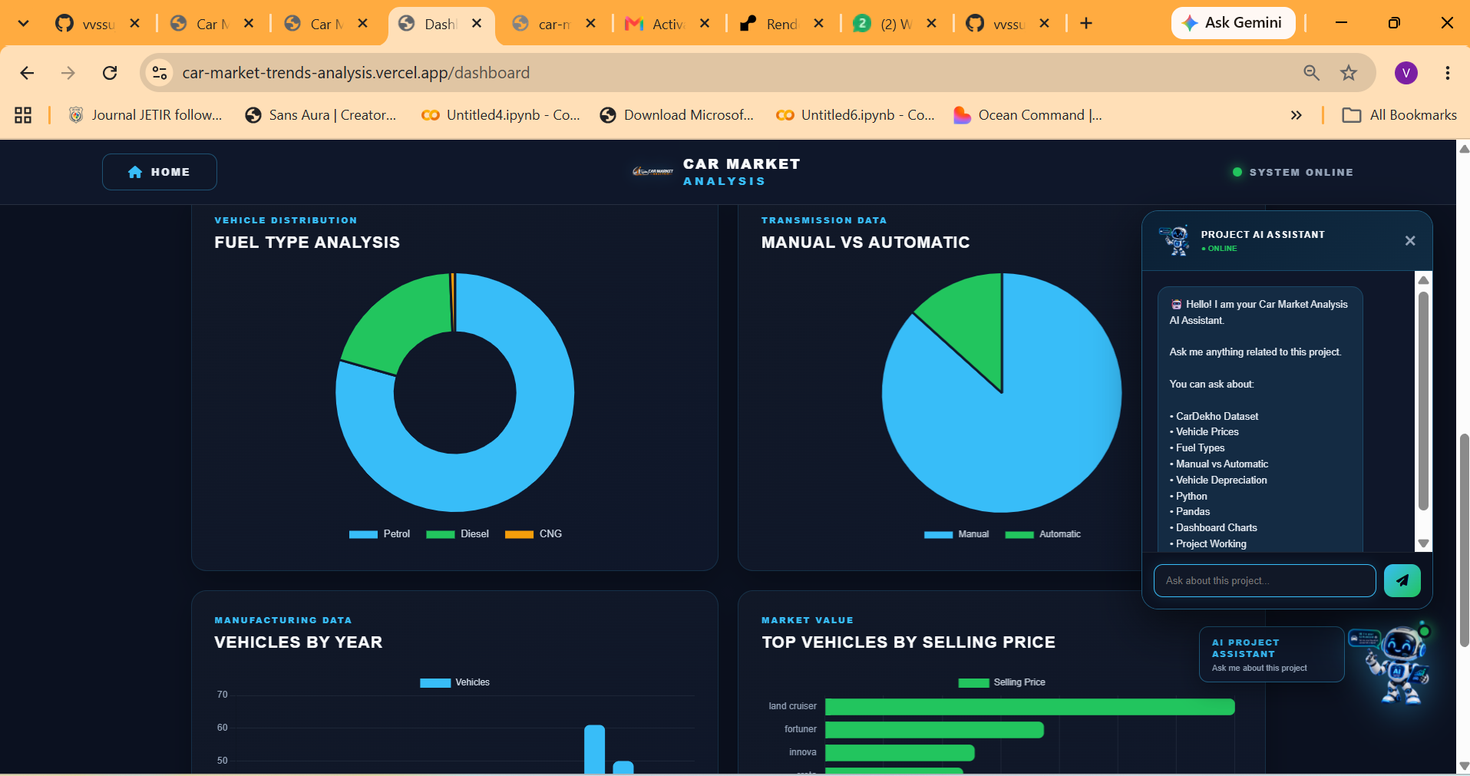
RESULTS
[Add screen shots of your code ]
Demo Link

Slide 18
Thank you
.
.

